Slide 1
NHS Dig Data Challenge
Mohammed Faisal

Slide 2
Top 10 Drugs
Drug Name | Item
Sertraline hydrochloride | 85402251
Amitriptyline hydrochloride | 59272937
Citalopram hydrobromide | 52891620
Mirtazapine | 46335570
Fluoxetine hydrochloride | 28211759
Venlafaxine | 21447209
Duloxetine hydrochloride | 14262656
Escitalopram | 6580386
Paroxetine hydrochloride | 4886615
Trazodone hydrochloride | 4861813

Slide 3
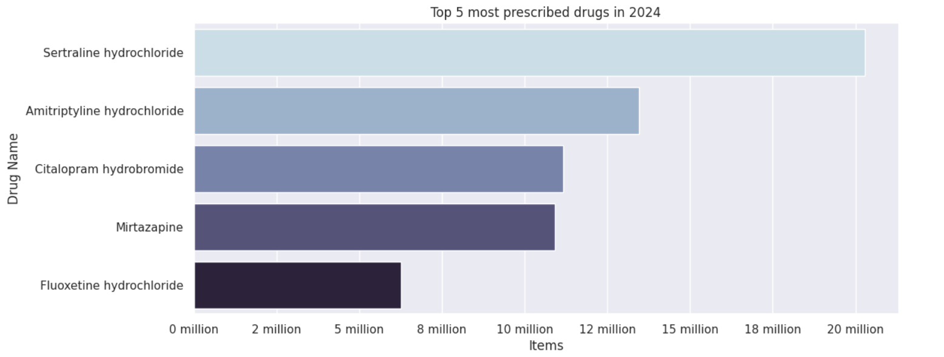
Most Prescribed Drug in 2024

Slide 4
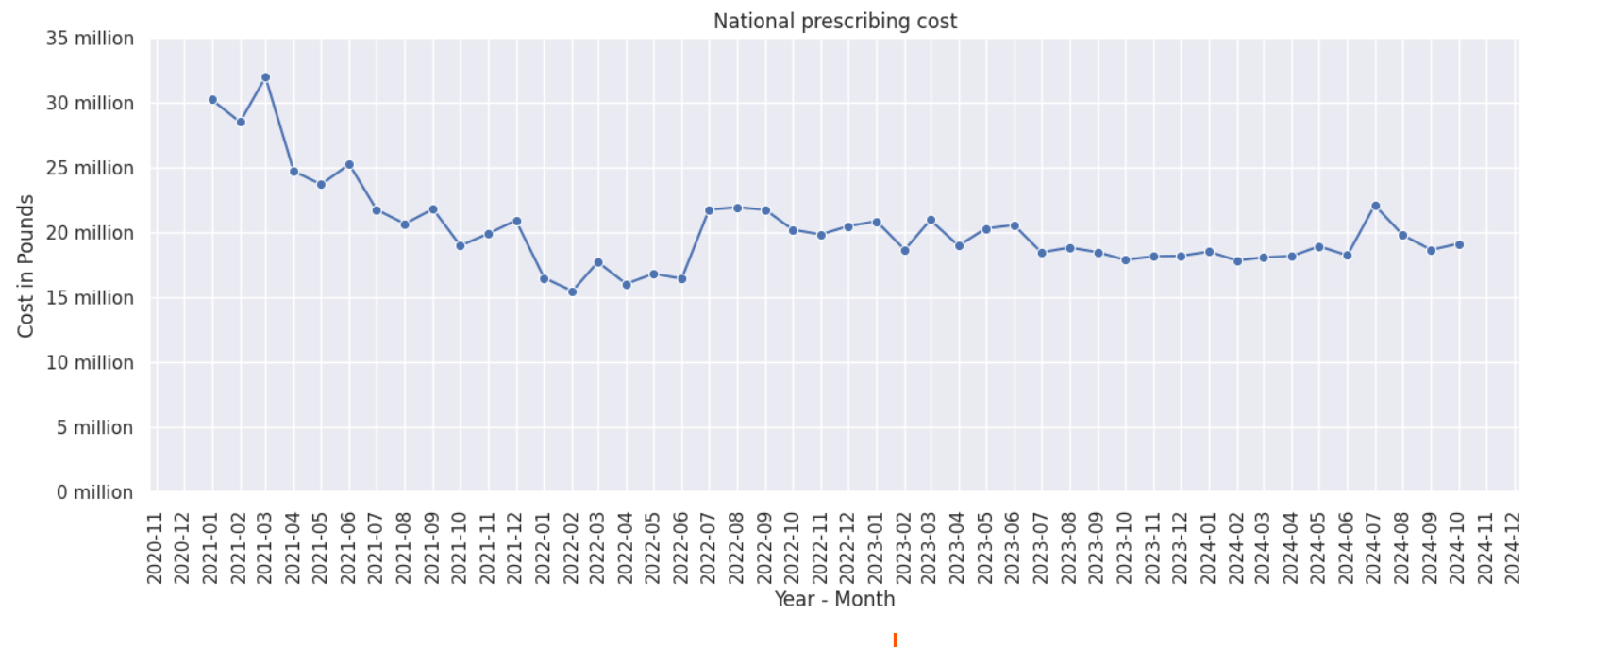
National Prescribing cost trend from 2021 to 2024

Slide 5
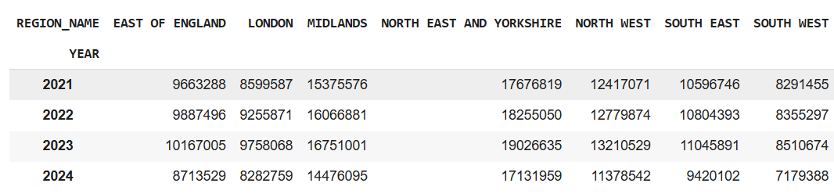
Prescription by region annually

Slide 6
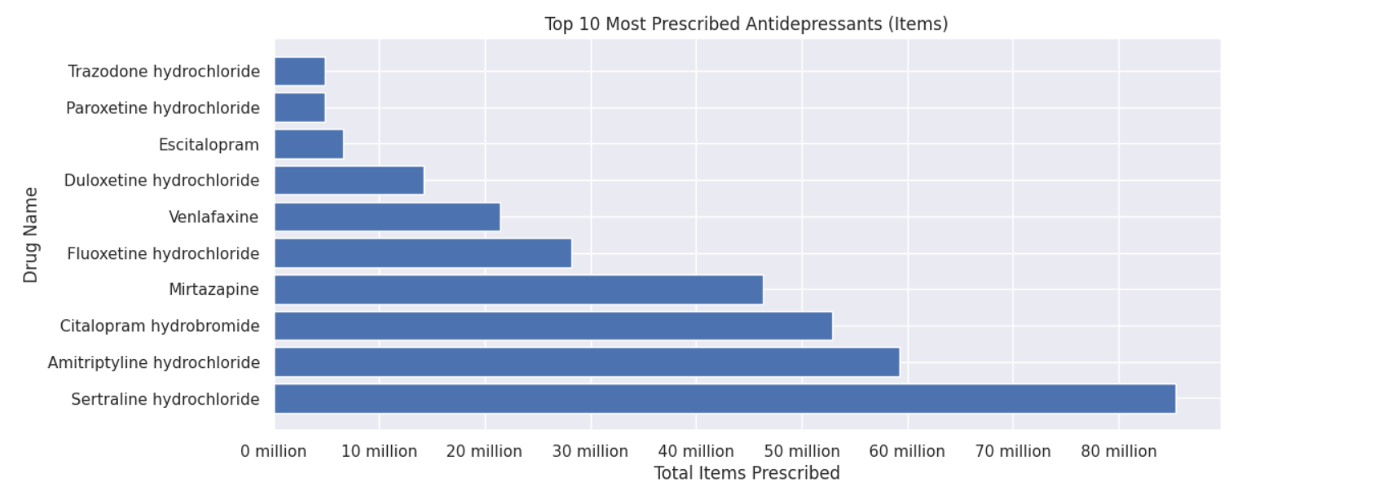
Top 10 drugs prescribed from 2021 to 2024

Slide 7
Conclusion
Sertraline hydrochloride is the most prescribed drug by item quantity and by total cost.
Venlafaxine is the second most prescribed drug by cost despite having fewer prescriptions in terms of item quantity, indicating a high price.
Trimipramine maleate, Tranylcypromine sulfate, and Vortioxetine appear among the highest total costs but are not among the top prescribed drugs by quantity.
Trazodone Hydrochloride, Paroxetine hydrochloride, and Escitalopram are among the top prescribed drugs but not by cost, likely due to the low price per item
Monthly prescribing cost has been decreasing since the start of 2021. With an average cost of £20,259,788
North East and Yorkshire have the greatest number of Antidepressants prescribed in this duration. East England has a surge in Antidepressants from 2021 to 2023.
South West has the lowest number of antidepressants prescribed but the trend is similar to other regions where it increases every year.

